Slide 1
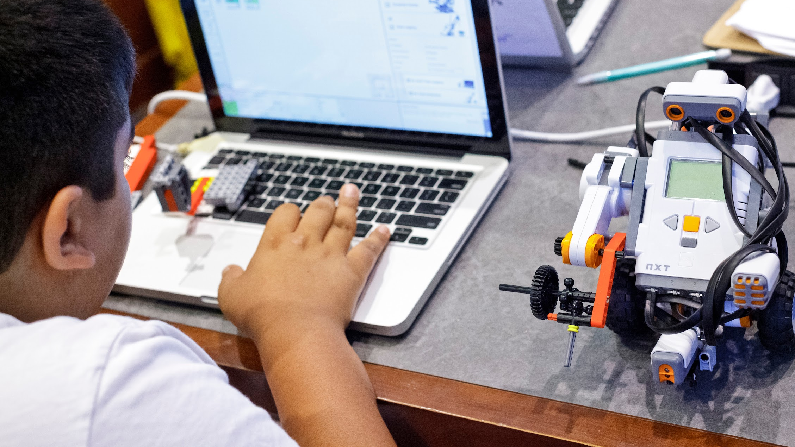
COMPUTER SCIENCE FOR EVERYONE, EVERYWHERE
Algorithms and Programming
NJDOE Standards 22E00178
NJDOE Hub 22E00173

Slide 2
Welcome!
Today’s Agenda: Understanding Algorithms and Programming
Fun with Robots!
Algorithms vs programming - what is the difference?
Algorithms - decomposing its elements
Helping students to connect to algorithms
Origami!!
Pseudocode - what is it and how does it help us?
Basic building blocks of Algorithms - and key skills to learn
Advanced - Understanding how long an algorithm takes to run.
Computer Science for Everyone, Everywhere (CSEE)

Slide 3
Activity: The Robot and the Sunflower Butter Sandwich
Robot is making a sandwich
What do we observe?
Can you make directions to help Robot?
Computer Science for Everyone, Everywhere (CSEE)

Slide 4
Algorithms, Programming and Why all the fuss?
What is an Algorithm (we saw this in CT)?
Informally: An Algorithm is a step by step process by which we complete a task.
Formal definition: An algorithm is an ordered set of unambiguous, executable steps that defines a terminating process
What is Programming?
Programming is a representation of an algorithm into a form that the computer can understand.
How are they related?
Computer scientists develop algorithms and test them through math to solve problems. Then we use programming languages to develop software based on those algorithms.
Computer Science for Everyone, Everywhere (CSEE)

Slide 5
The Anatomy of an Algorithm
An algorithms definition is deceptively simple: A step-by-step process by which we complete a task. There are many important elements to this definition!
Formal definition: An algorithm is an ordered set of unambiguous, executable steps that defines a terminating process
What is important:
It is ordered
It is step-by-step and its very clear steps
It is possible for the computer to do those steps
There is a clear way the algorithm ends
There is a result at the end of the algorithm
Computer Science for Everyone, Everywhere (CSEE)

Slide 6
Algorithms: It has order!
The key design factor for algorithms is that it has order.
Why is order important?
Often a step is dependent upon a previous step. We need to follow the direction like a path or recipe.
Is everything ordered on a computer?
Not everything in computing requires order - in fact, for many things to work they have to unordered or even random. This is one of the reasons why we say clearly it must be ordered.
Computer Science for Everyone, Everywhere (CSEE)

Slide 7
Algorithms: It is step-by-step!
Related to ordered, there must be clear, precise steps that are followed in the algorithm. This is often the hardest part of algorithms because often the “math proof” lets you describe the concept every openly, but the programming implementation does not allow that.
We often start with a “high level” concept, then refine until we get to pseudo-code (notation that uses many common programming techniques). We usually work on about three versions of the algorithm, using problem solving techniques to get us to code.
Computer Science for Everyone, Everywhere (CSEE)

Slide 8
Algorithms: Three Versions
Working on algorithms is like writing a paper - and using a similar process for writing a paper helps.
Brainstorming
Begin with crafting a clear statement of what you want the algorithm to do. Include the following components: what is your input, what is your output, how does the algorithm end and describe in plain language how you want to go about getting to your end state/final output. Note - this should be in PLAIN LANGUAGE
Revision
You take your brainstorming and organize it. You begin to identify programming concepts that can implement your ideas.
Sometimes you need multiple revisions at this phase.
Your last revision should be in a good place where you know the code you need to use.
Translation: Translate the Revision into any programming language.
Computer Science for Everyone, Everywhere (CSEE)

Slide 9
Algorithms: Version Example - Brainstorming
Our problem is to create an adding program. It will add two numbers, return a result and then ask the user if they want to add something else.
Brainstorming:
I think about the program …
I am adding two numbers, so I will need to input two numbers and save those somewhere. Then I have to add them. Then I have to tell the user the result. Then I have to see if they want to do it again.
Considerations:
How am I getting the two numbers that I am adding? Are they typing it in or am I using a Graphical User Interface (windows, something they touch) to get the info?
Computer Science for Everyone, Everywhere (CSEE)

Slide 10
Algorithms: Version Example - Revision 1
Brainstorm:
I am adding two numbers, so I will need to input two numbers and save those somewhere. Then I have to add them. Then i have to tell the user the result.
Revision 1
Get two numbers from user typing in number on the keyboard
I save them in a container that holds data -> variables
Add numbers and save in the result
Print out the result for the user
Computer Science for Everyone, Everywhere (CSEE)

Slide 11
Algorithms: Version Example - Revision 2
Revision 1 - with more details -> Revision 2
Get two numbers from user typing in number on the keyboard
Get first number through an input statement
Assign my result to variable number1
Get second number from an input statement
Assignment my result to variable number2
I save them in a container that holds data -> variables
This work was done in the above steps.
Add numbers and save in the result
Create a result variable to hold the value of the addition.
Add number1 and number2 - save the addition value in variable result
Print out the result for the user
Use an output statement to the print out result
Computer Science for Everyone, Everywhere (CSEE)

Slide 12
Algorithms: Version Example - Translation phase
Revision 1 - with more details
Get two numbers from user typing in number on the keyboard
Get first number through an input statement
Assign my result to variable number1
Get second number from an input statement
Assignment my result to variable number2
I save them in a container that holds data -> variables
This work was done in the above steps.
Add numbers and save in the result
Create a result variable to hold the value of the addition.
Add number and number 2 - save the addition value in variable result
Print out the result for the user
Use an output statement to the print out result
Pseudo-code (looks like code but independent of language)
number 1 = 0
number1 = input(““Please enter your first number to be added: “)
number 2 = 0
number2 = input(““Please enter your second number to be added: “)
result = 0
result = number1 + number2
print(“Your result is “ + result)
Computer Science for Everyone, Everywhere (CSEE)

Slide 13
Algorithms: Techniques for development
We use three basic techniques to develop our algorithms:
Top-down approach
Top-down is what we did in the previous example. We start with a High-level idea and we revise it, breaking it into smaller parts until we can visible see the coding elements needed to create the program.
Top-down approach uses a concept called step-wise refinement. This means you do multiple versions of your outline, breaking up each bullet point again and again until your bullet points can be easily translatable into code.
We often use the Divide and Conquer Technique in Top Down - breaking the problem into smaller, more manageable pieces.
Computer Science for Everyone, Everywhere (CSEE)

Slide 14
Algorithms: Techniques for development
Bottom Up Approach:
Design a problem that you want to address with an algorithm
Then look at problems similar to it.
Use the pieces from other programs to build out your solution.
Bottom up is an engineering technique where you have goal x and supplies y, how do you get to your goal?
Combination of the two approaches
The reality is we use both approaches often together to get a robust solution.
Trying to look at problems from different points of view often help us with understanding where problems are in our logic.
Computer Science for Everyone, Everywhere (CSEE)

Slide 15
Algorithms: A computer can complete the task
Computers work in binary: yes and no, one and zero, true and false.
The computer isn’t good with “loose instructions” or instructions that are indefinite.
It is impossible for the computer to do the following instruction:
When you are done enjoying the sunset, do this step.
Therefore the instruction must be able to end.
Computer Science for Everyone, Everywhere (CSEE)

Slide 16
Algorithms: It Ends
It must end. When try to design with infinity with caution.
For the most part, the only place that we work with the program being allowed to run infinitely are systems programs - the operating system, the computer security features, etc.
These programs work on the idea that they run infinitely until an “interrupt” event occurs. We assume a lot of interrupts will happen.
These programs are then ended either by an interrupt or the user turning off the devise.
Computer Science for Everyone, Everywhere (CSEE)

Slide 17
Algorithms: There is a result at the end
The purpose of the algorithm is to manipulate the data in some way - therefore by the time the algorithm ends - something should have happened with the data.
Examples:
Something was stored
Something was printed or reported to the user
A value changed
A value was visualized in a cool way
A set of values were analyzed
etc…
Computer Science for Everyone, Everywhere (CSEE)

Slide 18
Origami Break!!
Let’s take an origami break.
As you complete this task, recognize the relationship of creating origami objects and algorithms.
Computer Science for Everyone, Everywhere (CSEE)

Slide 19
Origami Debrief
Were you able to make the object?
What helped?
What more did you need?
Computer Science for Everyone, Everywhere (CSEE)

Slide 20
Origami Primitives and Programming Primitives
Most of us do not practice origami frequently.
The exercise provided a list of syntax to help with the directions.
That syntax had primitives for origami. We built on those primitives to create our bird.
Programming has primitives too - common “constructs” that tend to occur in most programming languages.
Computer Science for Everyone, Everywhere (CSEE)

Slide 21
Programming
Computer Science for Everyone, Everywhere (CSEE)

Slide 22
What do the Standards Tell Us
An algorithm is a series of steps in a specific order used to solve a problem
The need to follow steps
The steps need to be able to be processed by a computer
There are often many ways to solve problems, each with strengths & weaknesses
Algorithm performance can be measured to evaluate design choices
Computer Programming relies heavily on Abstractions
Instructions are abstractions for complex tasks. Key programming components are also abstractions (variables, statements, procedures)
Variables are representations for memory locations
Structures such as loops (repetition) and if statements (selection) allow a sequence of steps to be altered
By using abstractions, complex tasks can be broken down into simpler instructions
Procedures facilitate the development of code by improving readability, promoting code reuse and simplifying testing and improving reliability
Data structures are chosen to improve algorithm design. Lists, arrays, dictionaries all provide was to organize data for more efficient processing
Computer Science for Everyone, Everywhere (CSEE)

Slide 23
What do the Standards Tell Us (cont)
People work together to develop programs for a purpose
Collaborative development often yields better results than independent efforts
Teams allow complex programs to be broken down for faster development
Team development broadens the group knowledge and expertise
Program development life-cycle involves many steps
Understanding goals and requirements
Developing and designing the algorithms necessary to solve a problem
Writing code to implement the instructions/algorithms
Testing code to identify problems and verify the solution meets the requirements
Training and distribution of the solution
Gathering feedback to identify opportunities for improvement/enhancement
The process is iterative
By High School, understanding common algorithms will provide a solid foundation
Iterating lists, search and sorting algorithms, using PRNG, String manipulation
Calling procedures (with parameters),, using parameters to affect algorithm flow
Computer Science for Everyone, Everywhere (CSEE)

Slide 24
Programming Languages
Programming languages are tools computer scientists use to give directions to a computer to do a task. Most general purpose computers use software to run the computer.
The computer - which understands binary - is near impossible for the human-programmer or human user to understand directly.
Programming languages help us author software. They consist of:
An interface for the human-programmer to use:
An interactive interface that offers tools for authoring code - graphical user interface or user interface
A “shell” command line - where you write your commands in plain text and directly interact with the program.
A program that “converts” the source code to the machine code - often this is done through multiple steps. This program is usually called a compiler or an interpreter.
Computer Science for Everyone, Everywhere (CSEE)

Slide 25
Most programming languages include the following types of statements:
Variables: A name in a place in memory for data I want to manipulate in the program.
Input and output statements: Statements that let me get input or output from the user.
Assignment Statement: The way we put data into variables.
Data Types: This is data with actions that we can do to that data.
Operations (mathematical, logical, boolean: Basic mathematical statements that let me manipulate data.
Conditional statements - statements that let me make a decision in the code.
Repetition statements - statements that let me repeat the same code again and again until either a variable reaches a certain value (counting) or a certain event occurs (sentinel).
Containers: ways to group data together.
Functions, procedures, methods, subroutines, behaviors: code that has been grouped together to perform a specific task.
Computer Science for Everyone, Everywhere (CSEE)

Slide 26
Variables
Variables: A name in a place in memory for data I want to manipulate in the program
Different programming languages handle data differently.
A variable gives a name or handle for a piece of data in memory.
Computer Science for Everyone, Everywhere (CSEE)

Slide 27
Input and output statements:
Everything the computer does has inputs and outputs
Input: Any data that the program needs in order to run.
Output: The result of the program.
Standard Input - the keyboard
Standard Output - the monitor/screen
Overwhelmingly, most input comes from a resource or a stream - that is a file, a database, data collected on-line.
Computer Science for Everyone, Everywhere (CSEE)

Slide 28
Assignment Statements
An assignment statement usually has a variable on the left side and then a mathematical expression on the right side. It allows me to modify data values held in a variable.
My_variable = myvariable * 5
Computer Science for Everyone, Everywhere (CSEE)

Slide 29
Data Types
A data type is data and actions I can do to that data.
Integer:
Data: positive and negative whole numbers and zero
Actions: addition, subtraction, multiplication, division, modulo (remainder)
String
Data: a sequence of characters
Actions: append, substring, print
Boolean
Data: True or False
Actions: AND, OR, NOT, XOR
Other popular data types: Decimal (float), Date, bit, long int, Double precision
Computer Science for Everyone, Everywhere (CSEE)

Slide 30
Operations
Operations are actions we can do to the data. They follow the same rules as math operator precedence.
Mathematical operations: addition (+), subtraction (-), multiplication (*), division (/), modulo (%), exponents(**).
String operations: concatenation (+, .)
Logical operations: Less than(<), less than or equal to(<=), Greater than (>), Greater than or equal to (>=), equal to (==), not equal to (!=).
Boolean operations: AND, OR, NOT, XOR
Computer Science for Everyone, Everywhere (CSEE)

Slide 31
Conditional Statements
Conditional statements control the flow of the code. Where, given a choice, the program will follow a line of code based on a value that has occurred.
Common Notions in Psuedocode:
WHILE – a loop (iteration that has a condition at the beginning)
​
FOR – a counting loop (iteration)
REPEAT – UNTIL – a loop (iteration) that has a condition at the end
IF – THEN – ELSE – a decision (selection) in which a choice is made
If-Then-Else Statements and Case State create conditionals:
if( a certain statement is true)
Do these actions
Else
Do these other actions
Computer Science for Everyone, Everywhere (CSEE)

Slide 32
Repetition Statements
There is a saying - if you have to do something once, do it by hand, otherwise write a program.
Repetition statements let me repeat an action. Repetition (or Iteration) occurs so long as :
There is data that needs to be processed (Counting Loop)
A certain event or an occurrence occurs (Sentinel Loop)
The while loop is the primary looping structure:
While (user_input != 0) do
X = x+1
Input user_input
Computer Science for Everyone, Everywhere (CSEE)

Slide 33
Containers
We often have many variable that have the same purpose or
We have multiple variables that come together to model a complex topic
When we have this situation we use a container structure to help us keep everything together - Encapsulation.
Two common containers:
Arrays or Lists - an array or list is a structure that lets me group variables of the same purpose together. - Example would be a class list
Objects are ways to group data together with specific actions you can do to that data. These data often comprise aspects of one concept - for example a molecule.
Computer Science for Everyone, Everywhere (CSEE)

Slide 34
Functions, procedures, methods and subroutines
There are a lot of concepts we can “give a name to” but require multiple steps and can change depending upon the data
Example: average
Example: Area of a geometric shape - area of a square is not computing the same as the area under a curve.
We can group clearly defined concepts into a sub grouping of code called a function, procedure, method or subroutine.
A function takes in input through arguments, runs that data through your code and returns a result.
Computer Science for Everyone, Everywhere (CSEE)

Slide 35
Function example
float Class Average (array classlistgrades){
float totalgrades = 0.0
float totalgrades_counter = 0.0
While (there is an unprocessed grade){
currentGrade = Get an unprocessed variable from container array classlist
totalgrades = currentgrade + totalgrades
totalgrades_counter = totalgrades_counter + 1
}
Return totalgrades/totalgrades_counter
}
Computer Science for Everyone, Everywhere (CSEE)

Slide 36
Finishing up - lets talk about a dictionary
How do you search a dictionary if I give your the word telomere?
Would you search page by page?
Would you find the middle and see what letter you hit? Then pick a side, and repeat until you get close to the center? Then the final few pages you search by hand?
If you chose the latter - this is a popular algorithm called binary search. The first one is linear search.
Computer Science for Everyone, Everywhere (CSEE)

Slide 37
Linear Search vs Binary Search
Linear search goes one by one
Binary search tries to halve what I search until I get very close to what I want.
If we assume the search takes 1 second and the word telomere occurs at page 1024 of the dictionary …
Linear search would take 1024 seconds
Binary search would take 10 seconds
Why is this?
Computer Science for Everyone, Everywhere (CSEE)

Slide 38
Measuring how quickly an algorithm runs
We measure an algorithm on its constructs.
Most constructs take Constant time.
However, when I use repetition and other more complex structures, it can get more complicated.
We refer to this study as asymptotic complexity and Big Oh notation.
We represent this measure with an algebra equation that describes the approximate time an algorithm takes.
Computer Science for Everyone, Everywhere (CSEE)

Slide 39
Plugged activity - Alice
Alice Programming is a lot like Scratch - where we plug and play concepts to create program.
Difference - it is for creating a story
https://www.alice.org/
Alice offers versions in English and Spanish
It allows your students to manipulate these concepts while creating a story.
Classic Maze - Code.org https://studio.code.org/hoc/1
Computer Science for Everyone, Everywhere (CSEE)

Slide 40
NEXT….
Take a 5 mins break.
Then go into small groups:
K2 Room X
3-5 Room X
6-8 Room X
9-12 Room X
For an activity demonstration and debrief
Computer Science for Everyone, Everywhere (CSEE)

Slide 41
Lesson demonstration
K2 Peanut Butter and Jelly (algorithms)
3-5 Psuedocode Activity
6-8 How to Solve a Long Division Problem?
9-12 Calculating the Max Value, Using PRNG, Sorting
For an activity demonstration and debrief
Computer Science for Everyone, Everywhere (CSEE)

Slide 42
How to Solve a Long Division Problem (Grade Band 6-8)
Definition a long division problem {here}:
Computer Science for Everyone, Everywhere (CSEE)

Slide 43
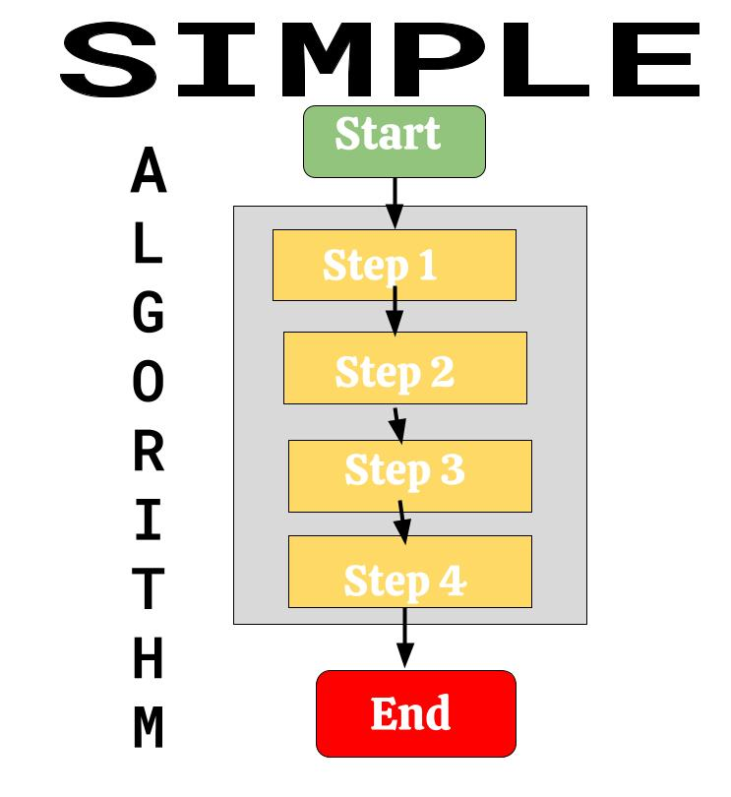
How to Solve a Long Division Problem (Grade Band 6-8)
Computer Science for Everyone, Everywhere (CSEE)

Slide 44
How to Solve a Long Division Problem (Grade Band 6-8)
Open link to Google Drawing
Computer Science for Everyone, Everywhere (CSEE)

Slide 45
Resources to teach: Algorithms and Programming
Scratch or Scratch Jr. (grades K and up)
Can you compute? (grades 5 and up)
https://www.canyoucompute.co.uk/l10-pseudocode.html
Computer Science for Everyone, Everywhere (CSEE)

Slide 46
K-2: Solve the Maze
Create an Algorithm
Lincoln A. Lawrence

Slide 47
INSTRUCTIONS
Drag the correct arrows to the empty boxes to go from the “Start” box to the “End” box.
Just click the arrows and drag them to the appropriate square.
You may not go through any solid blocks.
On a separate piece of paper, write down your algorithm for each slide.
It should look something like this:
The above example would stand for: down, right ,right, up, right, right, right,
The algorithm is simply the steps that you used to complete your maze.
Can more than one algorithm be created to complete the task? Do you need each direction (up, down, left and right) to complete this task? Hmmm.. Let’s find out.

Slide 55
My Favorite Algorithm

Slide 56
Vocabulary: Algorithms and Programming
Syntax: Meaning VARIABLE: Capitalized, variables store a number. set: Sets a VARIABLE equal to a number. input: Input a number to be stored in a VARIABLE. calculate: Performs mathematical operations. +, -, *, /, = : Add, subtract, multiply, divide, equals. <, <= : Less than, less than or equal to. >, >= : Greater than, greater than or equal to. | display: Prints information to the screen. if: If a condition is true, run its block of code. Otherwise, skip the block of code. else if: See if. Follows if statement and checks if a different condition is true. start loop: Begins a repeating block of code. repeat x times: Repeats a loop x times. end loop: Stops repeating a block of code.
Computer Science for Everyone, Everywhere (CSEE)

Slide 57
Debrief (in small groups, record answers on poster paper)
What works in this activity if you were to teach it?
What doesn’t work?
What considerations need to be made in advance?
How would you modify it for your class?
Takeaways?
Computer Science for Everyone, Everywhere (CSEE)

Slide 58
Thank you
Please complete the PD survey.
https://docs.google.com/forms/d/e/1FAIpQLScWKyCFc_Qh8_FDVUaHVCeJbZqdMuLXIysU3t4oj5FBH9vK6Q/viewform
PRESENTERS:
Minsun Shin shinm@montclair.edu
Scott Feinstein feinsteins@montclair.edu
Sumi Hagiwara hagiwaras@montclair.edu
Angela Williams-Nash a.nash@eastorange.k12.nj.us
Computer Science for Everyone, Everywhere (CSEE)

