Slide 1
New Faculty Workshop - October 2, 2023
Dr. Stefanie Brachfeld, Acting Vice Provost for Research
Kimberly Bazylewicz, Director of Research Compliance and Regulatory Programs, Office of Research Compliance
Ted Russo, Director, Office of Sponsored Programs
Christine Singh, Director, Office of Grant Accounting, Division of Finance and Treasury
Notes:
Stefanie: Intro to the Office of Research, its components, and role in the University’s research enterprise
‹#›

Slide 2
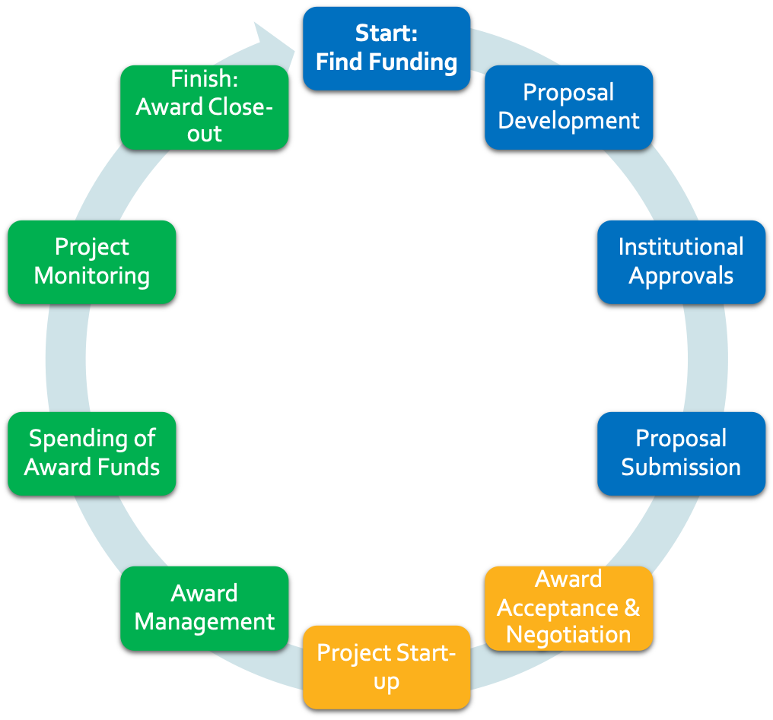
The Research Lifecycle
Responsible Conduct of Research
Notes:
Stefanie: Intro to the Office of Research, its components, and role in the University’s research enterprise.

Slide 3
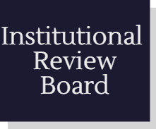
Research Integrity and Compliance
Compliance Areas
Notes:
Kim

Slide 4
Institutional Animal Care and Use Committee (IACUC)
https://www.montclair.edu/iacuc/
iacuc@montclair.edu
Carrie Laset, Compliance Coordinator
Dr. Lisa Hazard, Dept. Biology, IACUC Chair
Dr. Laura Conour, DVM, DACLAM, Attending Veterinarian
Sabrina Jung, Vivarium Director
Notes:
Kim

Slide 5
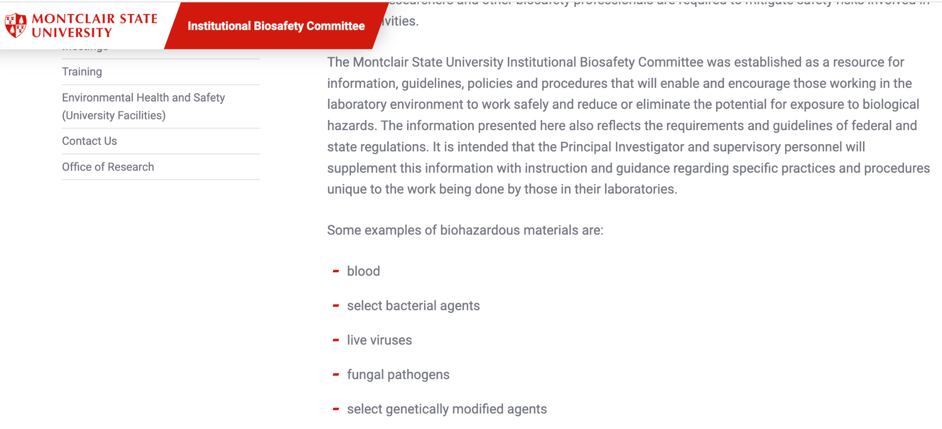
Institutional Biosafety Committee (IBC)
https://www.montclair.edu/ibc/
ibc@montclair.edu
Gena Coffey, University Safety Officer and Assistant Director of Environmental Health & Safety
Dr. Peter Hosick, IBC Chair, Dept. Exercise Science and Physical Education
Notes:
Kim

Slide 6
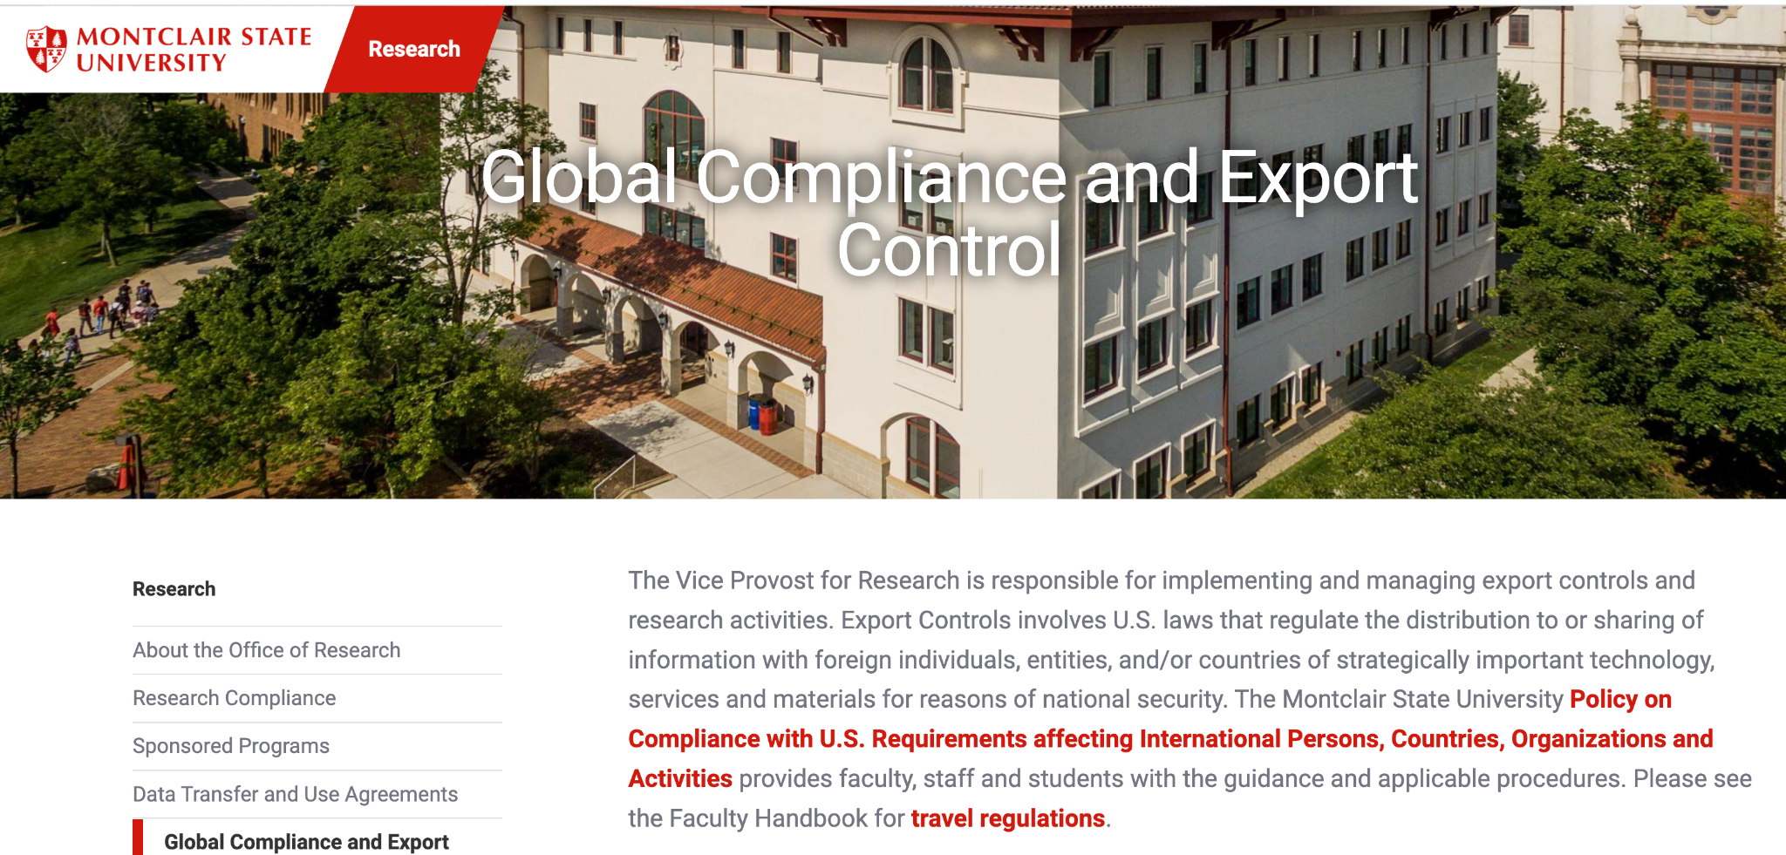
Global Compliance and Export Control
https://www.montclair.edu/research/global-compliance-and-export-control/
Global Compliance Email: exportcontrol@montclair.edu
Associate University Counsel - 973-655-5225
Research Compliance Officer - 973-655-7781
Director of OSP - 973-655-3219

Slide 7
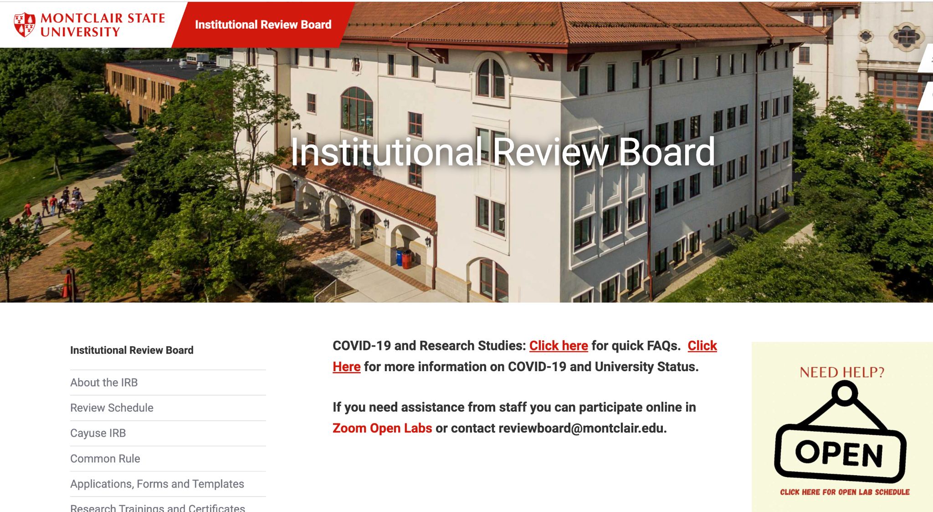
Institutional Review Board (IRB)
Mission: To support faculty, staff, students, and guests to complete their research that is compliant with federal and state laws and University policy. As such the IRB is charged to review, approve initiation of, and conduct periodic reviews of research projects that involve human participants.
https://www.montclair.edu/institutional-review-board/

Slide 8
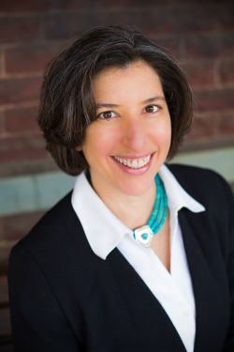
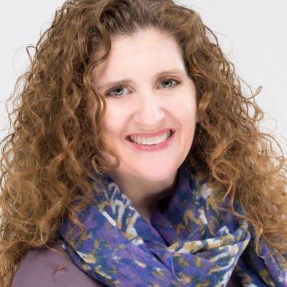
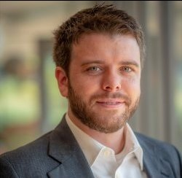
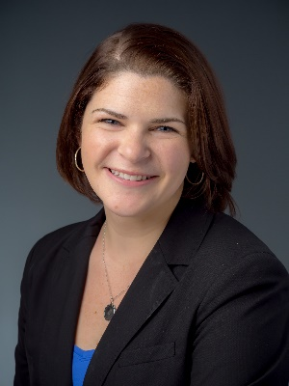
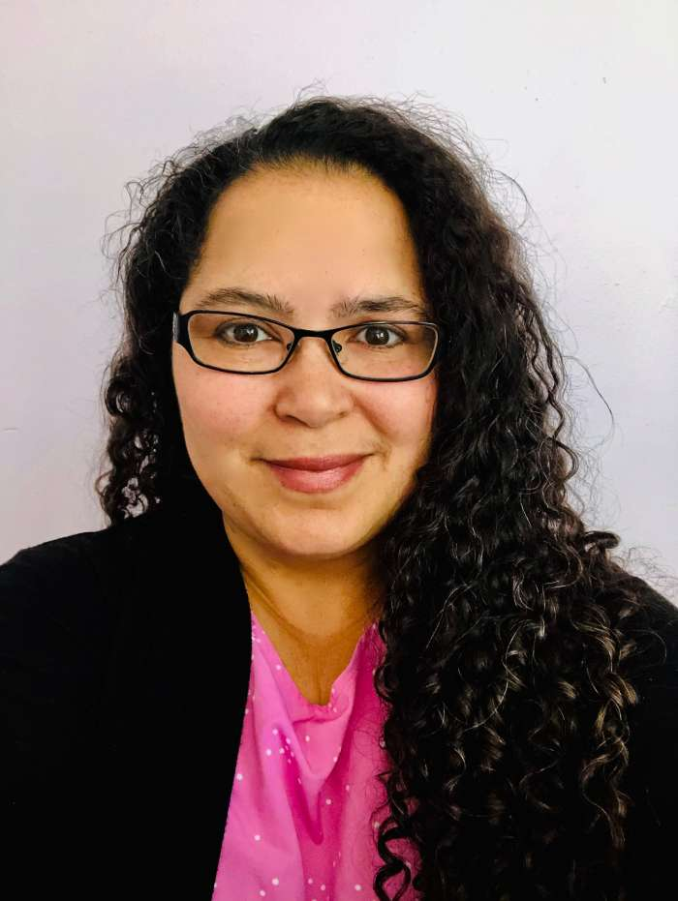
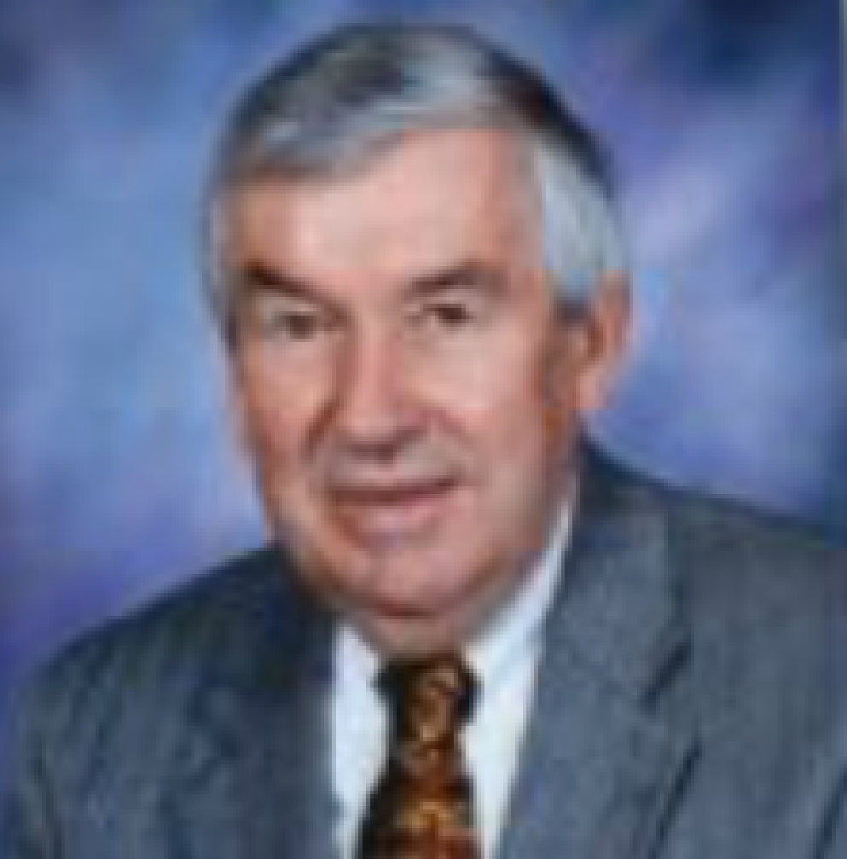
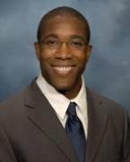
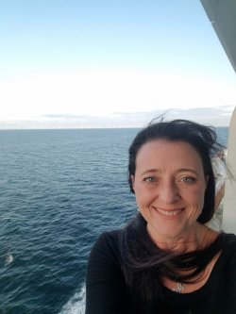
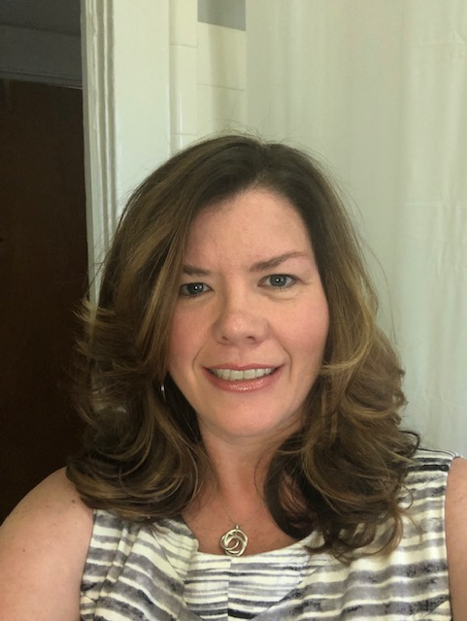
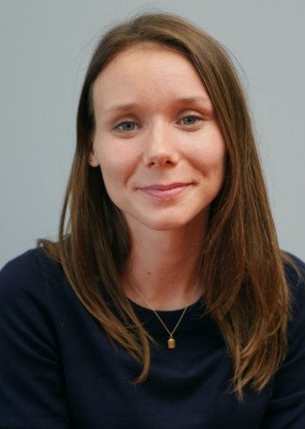
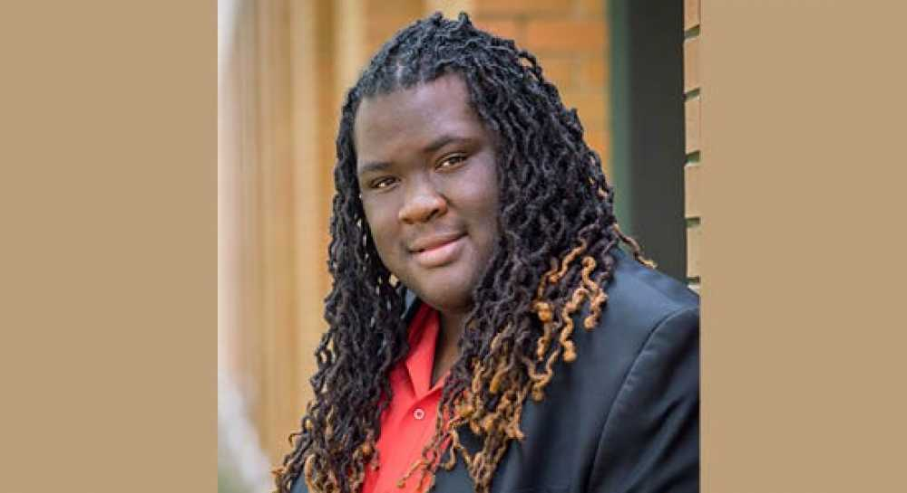
BOARD MEMBERS
10 Faculty /Staff and
1 Community member
‹#›
Notes:
‹#›

Slide 9
Not sure if what you’re doing is Human Subjects Research?
Submit a Research Determination Form (RDF) available in Cayuse IRB
Call or email the IRB for further clarification
IRB Chair or designated member will respond within 3-5 business days to determine if you need to submit an IRB application.

Slide 10
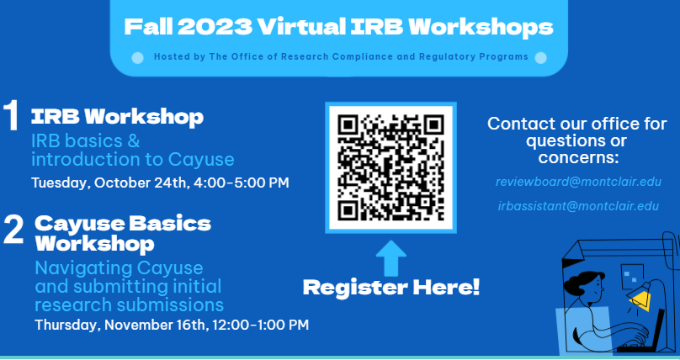
Resources Available
Request a copy of our recorded workshop by emailing: irbassistant @montclair.edu
Check out all of our info and instructions at: https://www.montclair.edu/institutional-review-board/cayuse-irb/

Slide 11
Transferring Human Subjects Research Activity to MSU
If you have an active approval at another institution you MAY need to apply with MSU IRB
If you are still publishing on the data and may have to revisit data you MAY need to apply with MSU IRB
If applying, include all previous approval letters and documentation with your full submission
Briefly describe your research activities conducted at your previous institution in the body of your email to reviewboard@montclair.edu

Slide 12
Understanding Faculty Sponsorship
FS is affirming research design and implementation by signing application
FS should provide training and oversight of student in conducting research
A FS should be a permanent faculty member (adjunct faculty and faculty from other universities cannot sponsor a student)
FSs must not only support a student’s application but the entire implementation of their research activity.
In Cayuse the FS will be the PI and the student will be the primary contact.

Slide 13
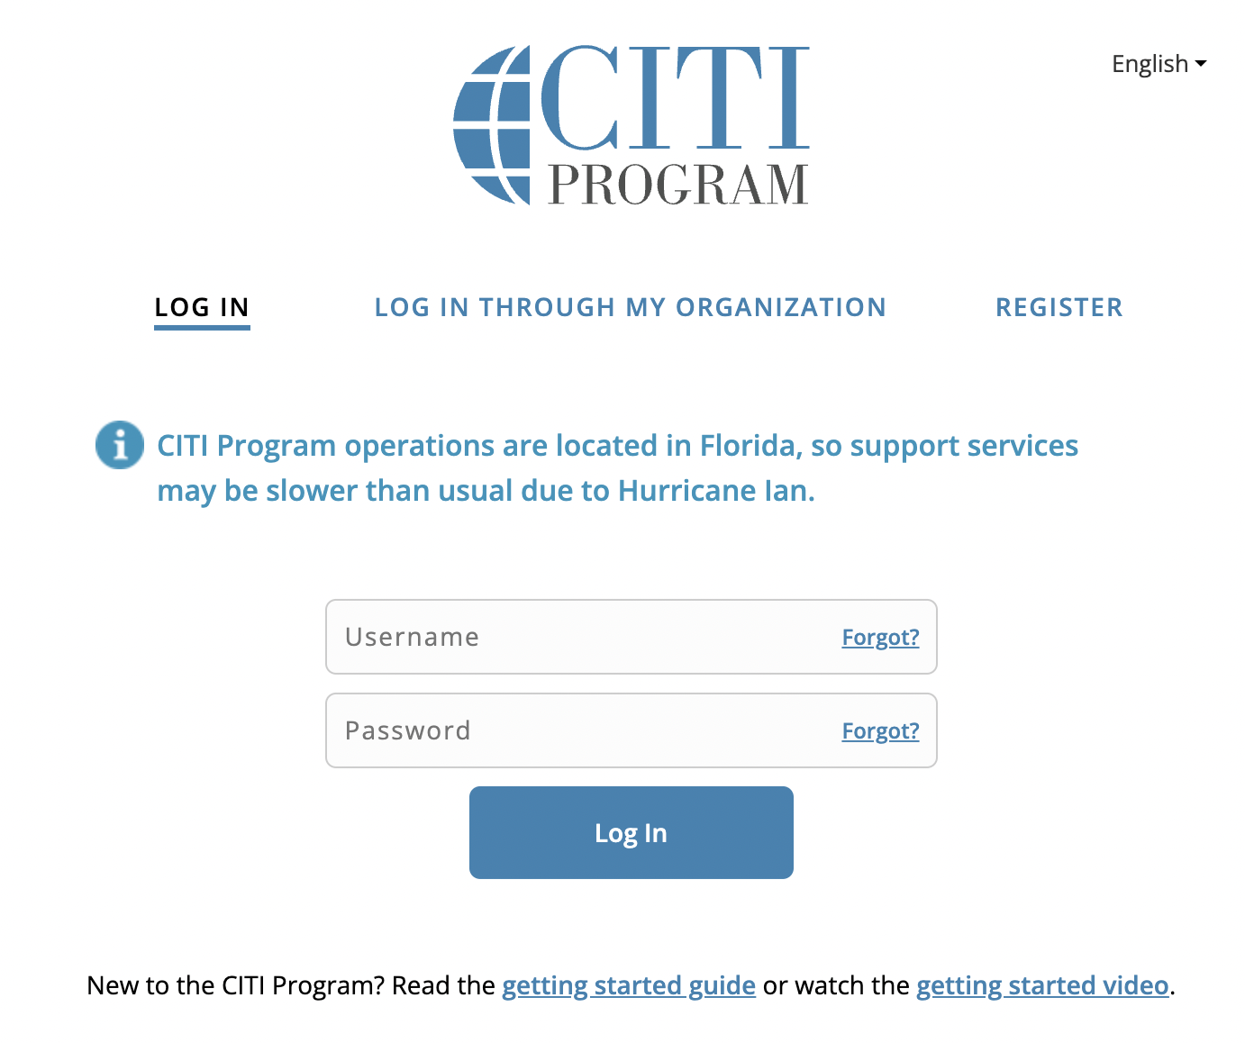
CITI Training
MSU requires that all faculty, staff, students, and visitors who conduct research that involves human participants must complete a training program on the protection of human participants
Est. time 2-4 hours (not in one sitting)
Valid for 3 years
Citiprogram.org
www.citiprogram.org/

Slide 14
Office of Sponsored Programs
Ted Russo, Director
Catherine Bruno, Senior Post-Award Officer
Kate Dorsett, Post-Award Officer
Amanda Lopez, Junior Pre-Award Specialist
Jonathan Parker, Proposal Development Manager
Sam Wolverton, Senior Pre-Award Specialist
Location: School of Nursing Room 415
Phone: x4128
e-mail: osp@montclair.edu
www.montclair.edu/sponsored-programs
Notes:
Ted to introduce staff and discuss POC procedures briefly (e.g. once you know you’re interested in submitting a proposal, etc.,)

Slide 15
The Research Lifecycle: People & Systems
Notes:
Ted to discuss quickly the 3 stages of the lifecyle, pre-award (blue), post-award (yellow), and financial post award (green) and the peopl;e who help and systems we use at each stage

Slide 16
Pre-Award: Proposal Preparation & Submission
A wealth of information! Just a FEW examples:
Services Provided
Find Funding
Proposal Submission Deadline Policy and Budget Templates
CAYUSE Research Suite
Let’s take a look!
www.montclair.edu/sponsored-programs
Notes:
Find Funding (Sam)
-Weekly Funding Blast
-Pivot and GRC
Proposal Submission Deadline Policy and Budget Templates (Jon)
Cayuse Research Suite Training Materials (Amanda)
‹#›

Slide 17
Post-Award: Award Management
(Non-Financial)
1.Award Receipt and Negotiation
•Award packet
2.Sponsor Prior Approvals: some examples
•No-cost Extensions
•Addition of a subaward
•Change in Key Personnel
Notes:
Catherine & Kate have completed this slide.

Slide 18
The Office of Grants Accounting (Post Award Financial)
Christine Singh, Director of Grants Accounting
Darryl Rivera, Grants Accounting Manager
Jay Wolk, Grants Accountant
Tracy Wells, Grants Accountant
Supreet Sethi, Grants Accountant
The Office of Grants Accounting is a part of the Finance and Treasury Division of Montclair State University
Location: The School of Nursing and the Graduate School, 4th Floor
Phone: (973)655-3627
E-mail: grantaccounting@montclair.edu
Website: https://www.montclair.edu/finance-and-treasury/university-controller/grant-accounting/

Slide 19
The Office of Grants Accounting (Post Award Financial)
The Office of Grants Accounting plays a crucial role in ensuring that funds are managed responsibly, in compliance with regulations, and in alignment with the scope of the grant. This helps our organization maintain transparency and accountability with sponsored funding.
AWARD SETUP
COMPLIANCE AND FINANCIAL MANAGEMENT
FINANCIAL REPORTING
CASH MANAGEMENT
AWARD CLOSEOUT
RECORD RETENTION
Notes:
Award Setup: This phase involves setting up the financial and accounting structure for a grant. It may include creating budgets, establishing accounting codes, and ensuring all financial systems are in place to manage the grant funds.
Budget Monitoring: Continuously monitoring the grant budget to ensure that expenses are within the approved budgetary limits. This involves reviewing expenses, reconciling accounts, and addressing any discrepancies.
Financial Reporting: Preparing and submitting financial reports to grantors or funding agencies as required by the terms of the grant. These reports often detail how the funds were used and whether they were used in compliance with grant guidelines.
Compliance Management: Ensuring that all financial activities related to the grant are compliant with federal, state, and local regulations, as well as the specific terms and conditions of the grant itself. This includes ensuring that expenditures are allowable, allocable, and reasonable.
Expense Tracking: Accurately tracking and documenting all expenses related to the grant, including payroll, supplies, equipment, and any other allowable expenses. This helps in maintaining transparency and accountability.
Audit Preparation: Preparing for and participating in audits, which may be conducted by the grantor, external auditors, or internal auditors. This involves providing documentation and answering questions related to grant expenditures and compliance.
Subrecipient Monitoring: If the grant involves subawards to other organizations or institutions, monitoring the financial activities of subrecipients to ensure they are compliant with the terms of the grant.
Award Closeout: Managing the process of closing out the grant once it reaches its end date or when all funds have been expended. This includes ensuring that all financial reports, deliverables, and documentation are submitted to the grantor as required.
Record Keeping: Maintaining thorough and organized records of all financial transactions related to the grant. This is essential for transparency, auditing, and compliance purposes.
Communication: Collaborating and communicating with various stakeholders, including grantors, project managers, researchers, and administrators, to ensure everyone is informed about the financial status and compliance of the grant.

Slide 20
Internal Awards:
Research, Scholarship, and Creative Activity Awards (RSCA)
Seed funding that leads to applications for external support
Open to individual and teams
Community-partnered RSCA
Student-led RSCA
Look for more information (via email)
in December
Notes:
Stefanie: I will explain the current circumstances, where we are in the timeline with Academic Affairs and AFT review

Slide 21
Internal Awards:
University Undergraduate Research Program
Newly initiative following a spring-summer pilot program
Cohort-based program for student-led projects under the guidance of a faculty mentor
Training and professional development activities provided for the students
Notes:
Stefanie. High priority item for Junius.

Slide 22
QUESTIONS?
Notes:
Catherine & Kate Suggestion: this

