Slide 1
Office of Research
Montclair State University
New Faculty Workshop - October 3, 2022
Montclair State University is New Jersey’s 2nd largest Public Doctoral Research University.
Our Carnegie Classification was updated in 2019 to “R2”, which stands for Doctoral University – High Research Activity.
Dr. Stefanie Brachfeld, Acting Vice Provost for Research
Kimberly Bazylewicz, Director of Research Compliance and Regulatory Programs, Office of Research Compliance
Ted Russo, Director, Office of Sponsored Programs
Notes:
‹#›

Slide 2
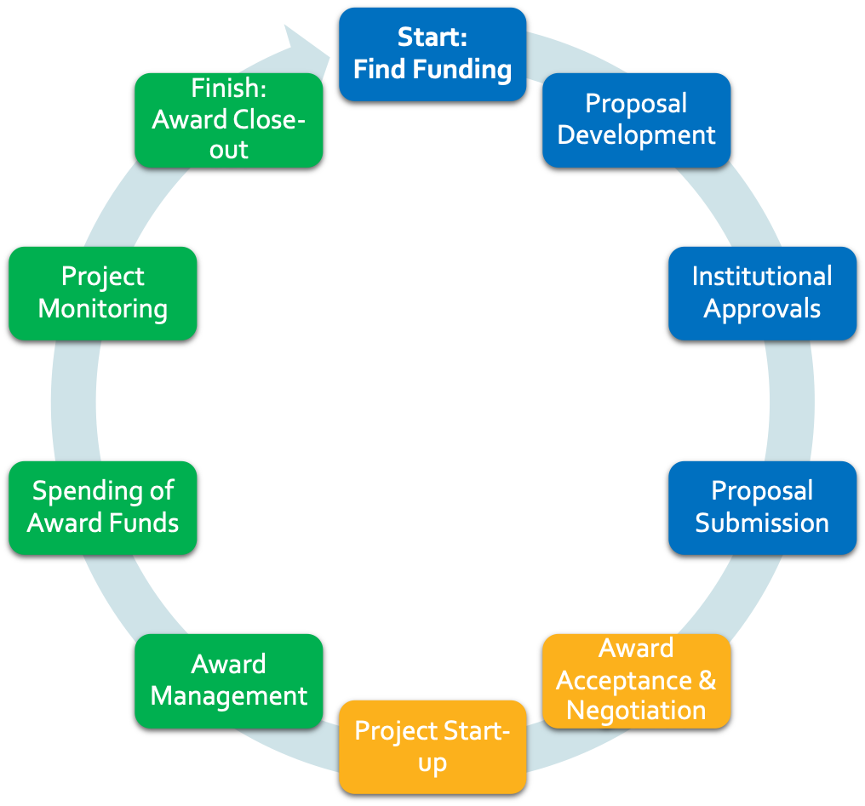
The Research Lifecycle
Responsible Conduct of Research

Slide 3
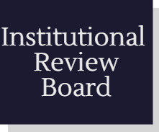
Research Integrity and Compliance
Compliance Areas
Notes:
SB: For the sake of consolidating, I added the “Research Integrity and Compliance” text from the previous slide as the title here.

Slide 4
Institutional Animal Care and Use Committee (IACUC)
https://www.montclair.edu/iacuc/
iacuc@montclair.edu
Carrie Laset, Compliance Coordinator
Dr. Lisa Hazard, Dept. Biology, IACUC Chair
Dr. Laura Conour, DVM, DACLAM, Attending Veterinarian
Sabrina Jung, Vivarium Director

Slide 5
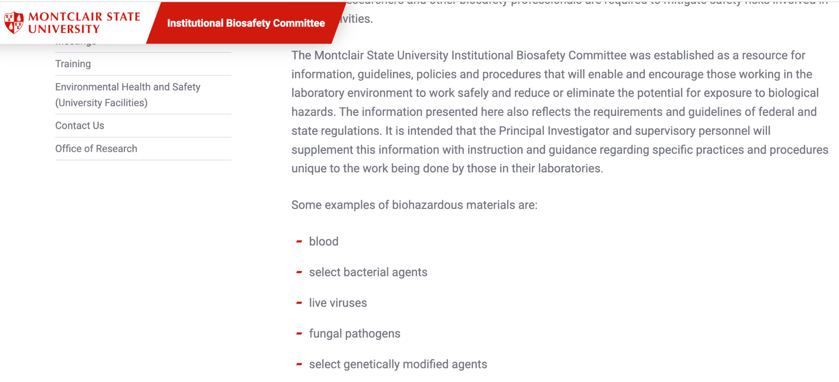
Institutional Biosafety Committee (IBC)
https://www.montclair.edu/ibc/
ibc@montclair.edu
Gena Coffey, University Safety Officer and Assistant Director of Environmental Health & Safety
Dr. Peter Hosick, IBC Chair, Dept. Exercise Science and Physical Education

Slide 6
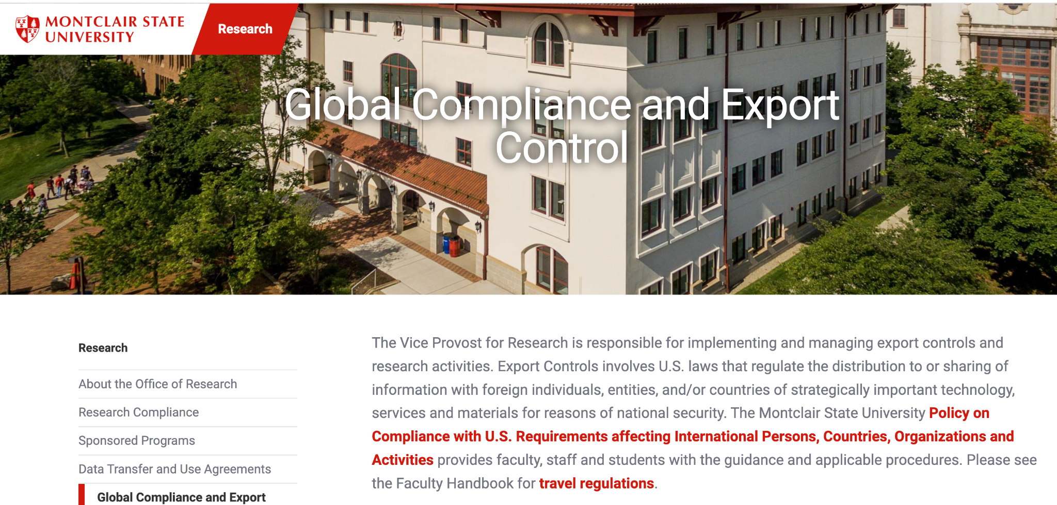
Global Compliance and Export Control
https://www.montclair.edu/research/global-compliance-and-export-control/
Global Compliance Email: exportcontrol@montclair.edu
Associate University Counsel - 973-655-5225
Research Compliance Officer - 973-655-7781
Director of OSP - 973-655-3219
Notes:
SB: Change contacts list to same style as other slides, with names and e-mail addresses?

Slide 7
IRB/Compliance Personnel
Dr. Dana Levitt, IRB Chair, Dept. Counseling
Kim Bazylewicz, Director of Research Compliance
Amy Krenzer, CIP, Senior Human Research Protections Analyst
Kat DeMarco, Compliance Coordinator
Carrie Laset, Compliance Coordinator
Offices in School of Nursing, Room 333

Slide 8
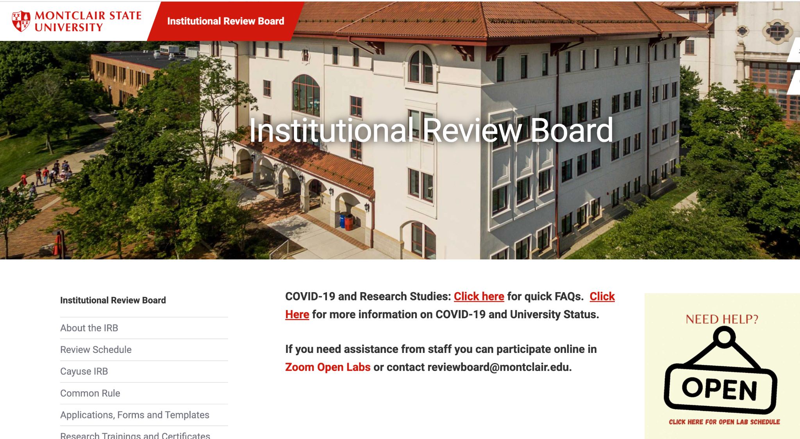
Institutional Review Board (IRB)
Mission: To support faculty, staff, students, and guests to complete their research that is compliant with federal and state laws and University policy. As such the IRB is charged to review, approve initiation of, and conduct periodic reviews of research projects that involve human participants.
https://www.montclair.edu/institutional-review-board/

Slide 9
IRB Mission
To support faculty, staff, students, and guests to complete their research that is compliant with federal and state laws and University policy. As such the IRB is charged to review, approve initiation of, and conduct periodic reviews of research projects that involve human participants.

Slide 10
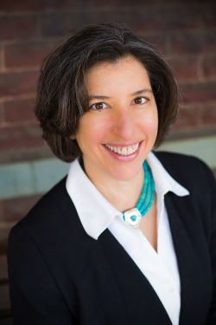
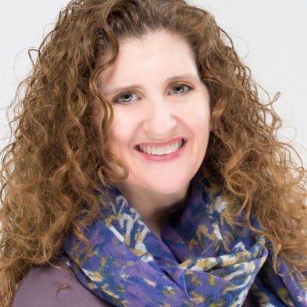
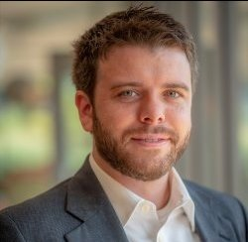
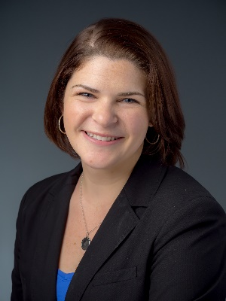
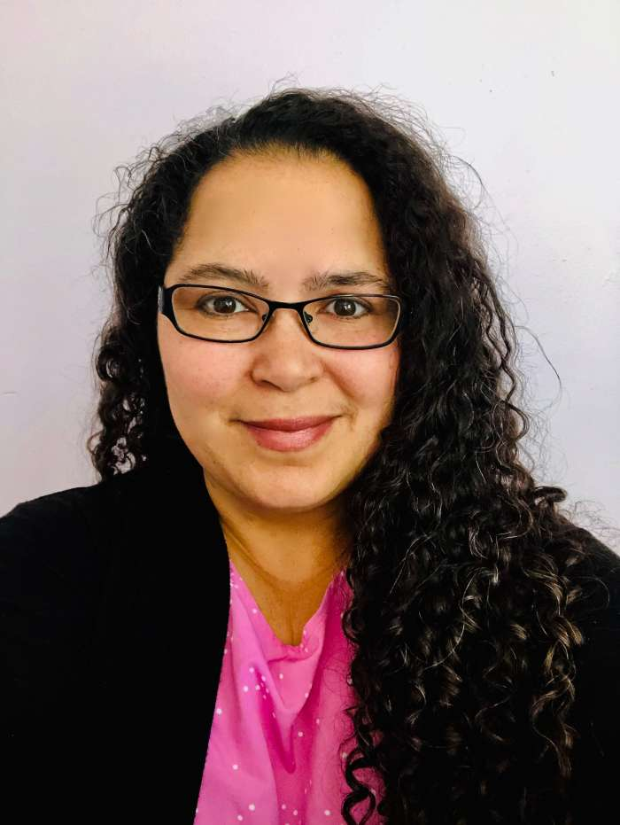
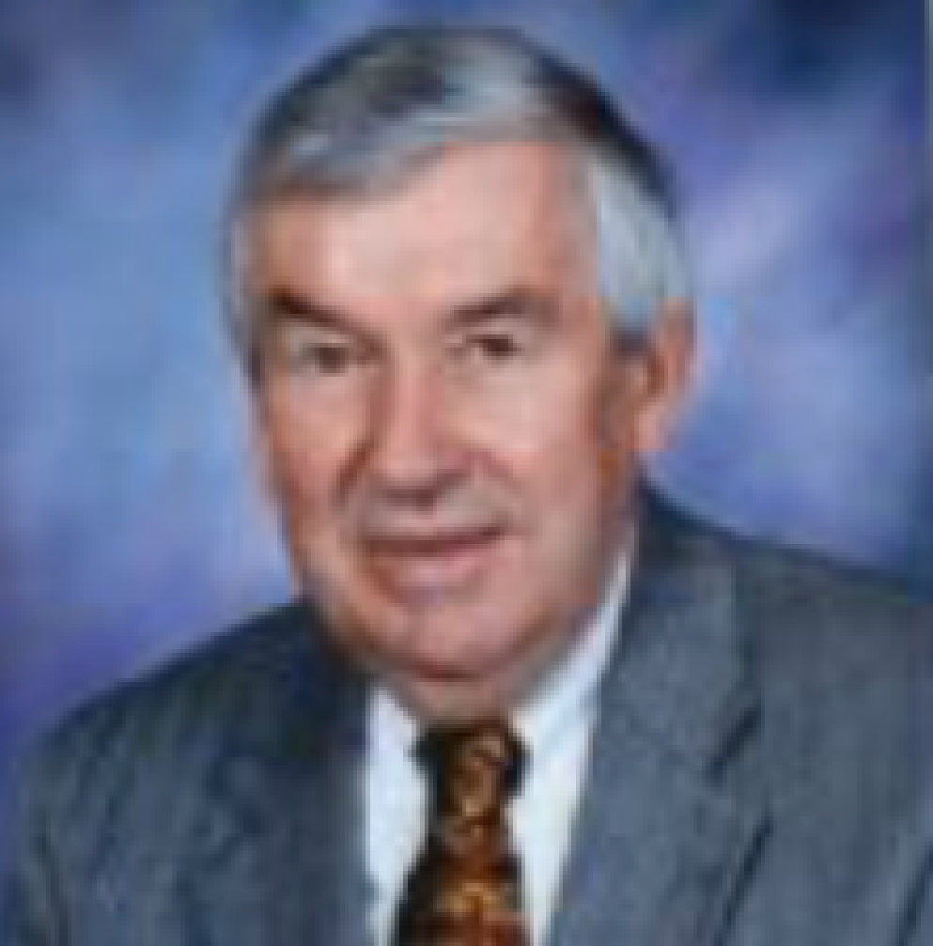
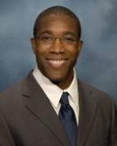
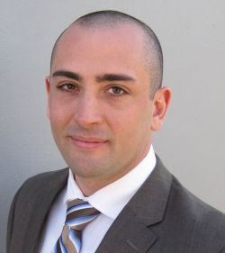
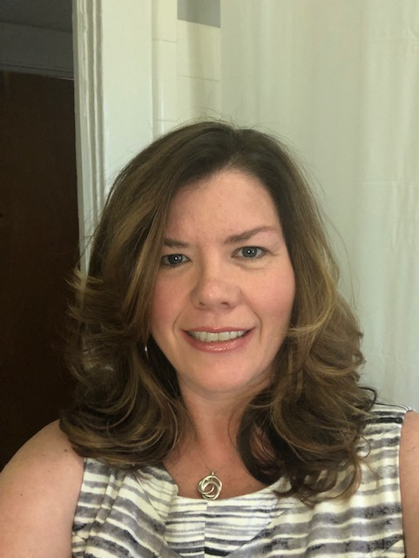
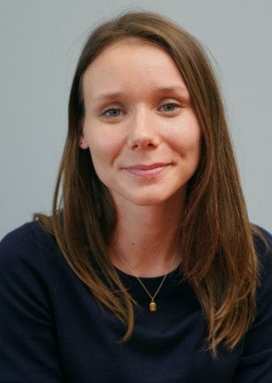
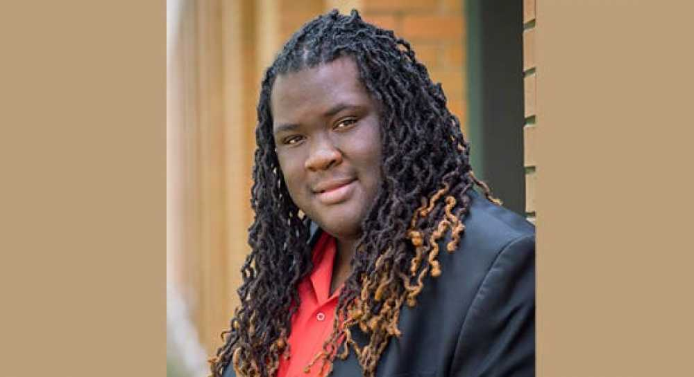
IRB BOARD
10 Faculty /Staff and
1 Community member
‹#›
Notes:
‹#›

Slide 11
Definition of Human Subjects Research
Human subject means a living individual about whom an investigator conducting research obtains:
1) data through intervention or interaction with the individual or
2) identifiable private information
Research is defined as systematic investigation that is hypothesis driven with the intent to develop knowledge that can be generalized.

Slide 12
Not sure if what you’re doing is Human Subjects Research?
Submit a Research Determination Form (RDF) available in Cayuse IRB
Call or email the IRB for further clarification
IRB Chair or designated member will respond within 3-5 business days to determine if you need to submit an IRB application.

Slide 13
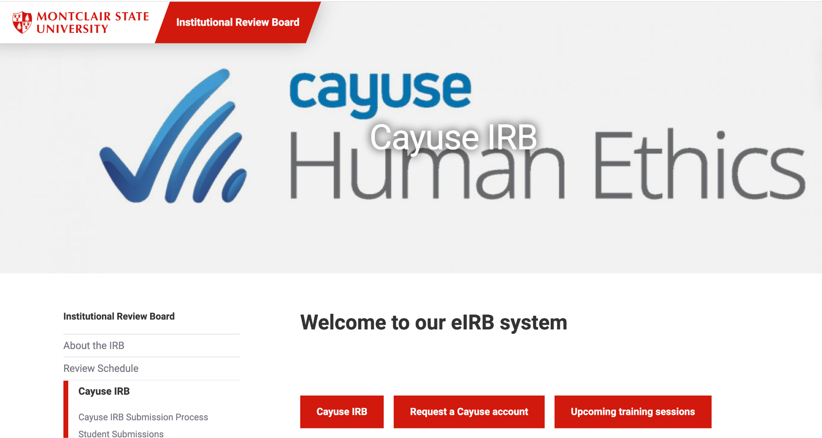
Preparing and Submitting Your IRB Proposal
https://www.montclair.edu/institutional-review-board/cayuse-irb/

Slide 14
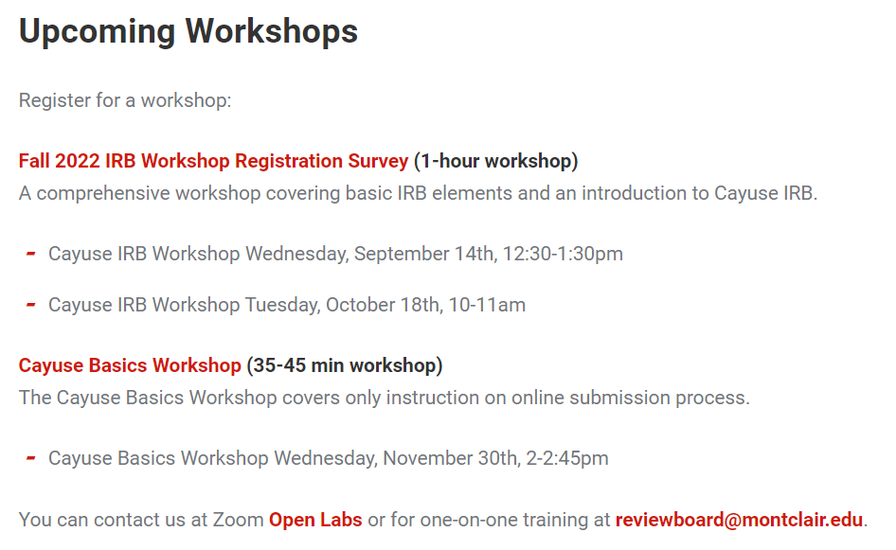
Resources Available
https://www.montclair.edu/institutional-review-board/cayuse-irb/cayuse-irb-training/

Slide 15
Transferring Human Subjects Research Activity to MSU
If you have an active approval at another institution you MAY need to apply with MSU IRB
If you are still publishing on the data and may have to revisit data you MAY need to apply with MSU IRB
If applying, include all previous approval letters and documentation with your full submission
Briefly describe your research activities conducted at your previous institution in the body of your email to reviewboard@montclair.edu

Slide 16
Understanding Faculty Sponsorship
FS is affirming research design and implementation by signing application
FS should provide training and oversight of student in conducting research
A FS should be a permanent faculty member (adjunct faculty and faculty from other universities cannot sponsor a student)
FSs must not only support a student’s application but the entire implementation of their research activity.
In Cayuse the FS will be the PI and the student will be the primary contact.

Slide 17
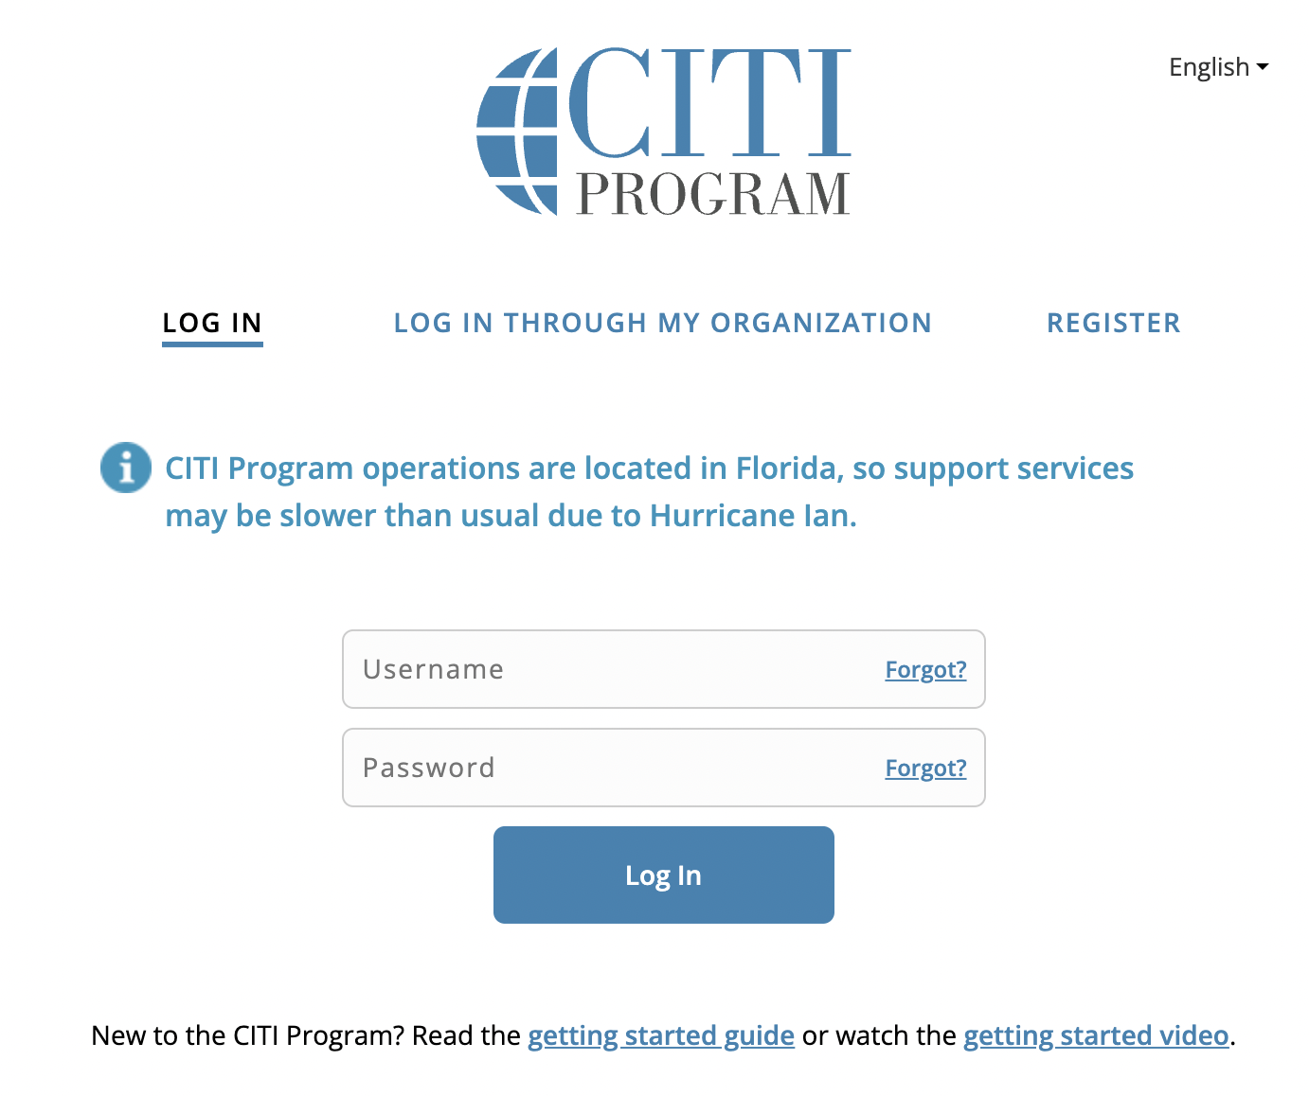
CITI Training
MSU requires that all faculty, staff, students, and visitors who conduct research that involves human participants must complete a training program on the protection of human participants
Est. time 2-4 hours (not in one sitting)
Valid for 3 years
Citiprogram.org
www.citiprogram.org/

Slide 18
Office of Sponsored Programs
Ted Russo, Director
Catherine Bruno, Senior Post-Award Officer
Christina Carter, Pre-Award Specialist
Kate Dorsett, Post-Award Officer
Amanda Lopez, Junior Pre-Award Specialist
Sam Wolverton, Senior Pre-Award Specialist
Location: School of Nursing Room 415
Phone: x4128
e-mail: osp@montclair.edu
www.montclair.edu/osp
twitter.com/ORSP_MSU

Slide 19
Grant specialists in Colleges/Schools
College of Education and Human Services:
Marshall Chaifetz, Grants Manager
University Hall, Room 2191
Phone: x4459
April Serfass, Post Award Facilitator
University Hall, Room 3132
Phone: x3072
College of Science and Mathematics
Gloria Rodriguez, Grants and Contracts Specialist
CELS 211
Phone: x5120

Slide 20
The Research Lifecycle

Slide 21
Pre-Award: Electronic Tools for Proposal Development, Preparation, and Submission
CAYUSE RESEARCH SUITE:
Cayuse SP- Internal Proposal Routing, Approval, Reporting and Proposal and Award Repository
CAYUSE Proposal- Direct Submission to Grants.Gov
PIVOT: Customized search for funding opportunities
InfoReady: Internal Awards and Limited Submission Competitions
Notes:
‹#›

Slide 22
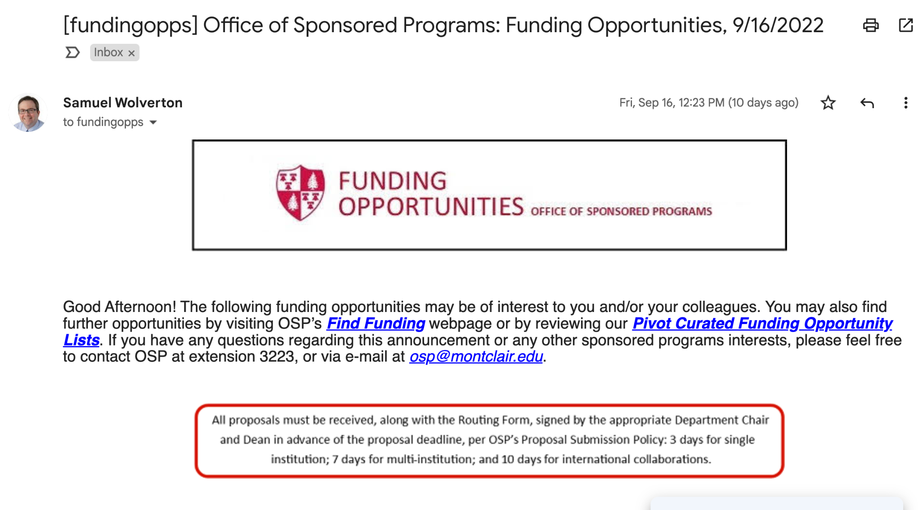
Pre-Award: Finding Funding
Funding Opportunities Listserv
Once a week, federal and non-federal opportunities

Slide 23
Pre-Award: Finding Funding
Pivot https://pivot.proquest.com
A global, multi-disciplinary database
Over $63 Billion in funding opportunities
More than 3 million profiles from around the world
Suggests potential funding opportunities for you based on your Pivot profile
New opportunities matching saved searches are emailed weekly
Faculty profile is searchable by other users for potential collaboration
Gives you one place to manage and track funding of interest
Grant Resource Center (GRC): Federal funding opportunities and sample Proposals (contact OSP for log-in information)
More links at https://www.montclair.edu/orsp/find-funding/

Slide 24
Internal Funding Opportunities
Currently undergoing much-needed revisions to meet needs of current faculty and goals of new leadership
Larger award amounts
Prioritizing new research, interdisciplinary activities, student research, and community-partnered research
Seed funding that leads to something bigger!
FY24 round (project period: 7/1/23 - 6/30/24) : Final cycle of current awards
Separately Budgeted Research
Student Faculty Scholarship
Faculty Research Mentoring
Look for more information (via email) in December!

Slide 25
QUESTIONS?

