Slide 1
New Syllabus Template (Fall 24: What You Need to Know
Presented by ITDS and OFE

Slide 2
Agenda
Why a new syllabus template?
What is it?
When will it be implemented?
How to use it
Q@A

Slide 3
Why a new syllabus template?
Teaching Principle 1: Clear Course Design
Provide clear expectations and explicit course learning goals to foster student success.
69% of first-year students and 71% of seniors reported that instructors “clearly explained course goals and requirements” very much/quite a bit.*
We fall below our peers in this regard.
*NSSE 2021 – link to full report

Slide 4
Syllabus Analysis Project
Question: How do syllabi using (1) Simple Syllabus, (2) “Montclair” Canvas template, and (3) faculty homegrown compare?
Method: 50 of each type of syllabi were randomly selected for review
Analysis: Double-scoring on a 3 pt scale on the 14 dimensions of syllabi (essentially, what we define as the expected elements); for example:
student learning outcomes (1=present, 2=present but incomplete/incorrect, 3=absent)

Slide 5
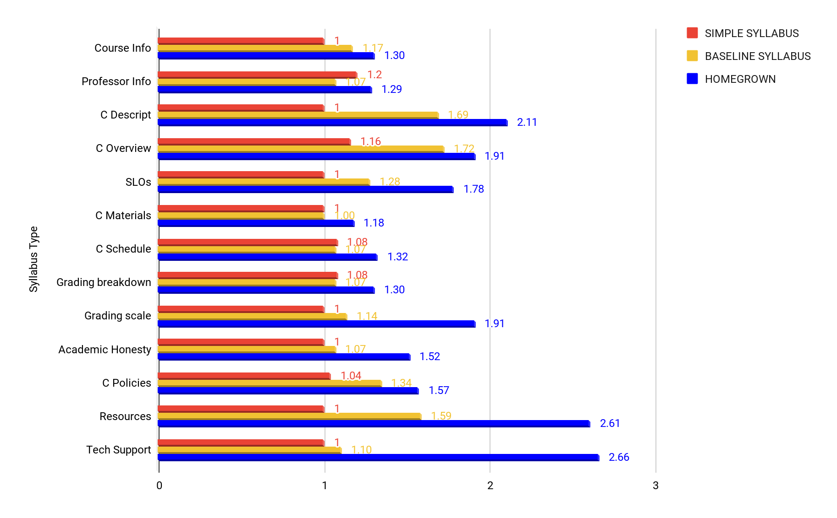
Syllabus Comparative Analysis Summary
Rubric
1= Present & complete
2 = Present but incomplete
3= Absent

Slide 6
Syllabus Analysis Project: Findings
Simple Syllabus versions were the most consistent in supplying the essential components. Some lacked complete information about the instructor (such as office/student hours)
Montclair Canvas template syllabi included most of the required components, but often had:
incomplete course descriptions
outdated resources and policies
Faculty homegrown syllabi more frequently lacked essential components and had outdated resources, if any. Common incomplete or absent components include:
course description
course overview
resources
course policies
modality

Slide 7
Syllabus Analysis Project: Findings (2)
Faculty homegrown had accessibility and logic issues, including:
Formatting not accessibility compliant
Files difficult to access
Many Canvas courses also showed the unedited, incomplete native Montclair template from the left-nav (which logically students would look at first)
Syllabi were located in a variety of places, with no direction from the homepage about where to find them, making them hard to find: for example:
Syllabus was only referenced in the first announcement of the semester
Syllabus was buried in the assignments of “files” section
Information not always presented logically
For example, course policies and grading breakdown both under “notes”
Grading scale included twice but different versions
Grading breakdown (in points) not translated to grading scale
Formatting unfriendly to scanning (all one font size, no headers, bold)

Slide 8
What is Simple Syllabus?
A centralized, template-driven platform that enables instructors to quickly personalize and publish interactive class syllabi.
Available in Canvas courses as “Montclair Syllabus.”
Template designed and project overseen by ITDS & OFE with an ad-hoc University Syllabus Steering Committee of faculty that meets periodically.
Sample Simple Syllabus syllabi (shared with permission):
Generic (plain template)
JUST220 (Chris Salvatore, WI2024)
ARST205 (Keith Adams, SP2024)
HUMN 202 (Catherine Keohane)

Slide 9
Helpful Features
Printable syllabi: Now available through Canvas.
Navigation: Improved sidebar shortcuts.
Updated info: Will receive up to date template updates (unlike baseline syllabus can have outdated data from course copies)
Consistency: Syllabi templates ensure key information is provided to students
Students
Template Builder: Receive templated and up-to-date information at university, college, subject, and course levels.
Auto-Population: Automatically fills in instructor information, class meeting times, location, course description, learning objectives, etc.
Tracks student views and percentage viewed.
Guided syllabus construction: Help text built into Simple Syllabus template guides instructors to include essential information that students need.
Updated resources: no need to track down for yourself.
Importable into other sections or semesters
Faculty

Slide 10
How Simple Syllabus Templates Content
Montclair State University
College of Humanities and Social Sciences
…
Psychology
…
PSYC101
…

Slide 11
Feedback from Pilot: Students and Faculty
Faculty
“I loved it and it was very user friendly and intuitive to use. It makes my syllabus look very professional. Also, in the previous question: How did Simple Syllabus impact the creation of your course syllabus? I wanted to choose "significantly improved" but that option was not available.”
“I feel that Simple Syllabus was a great addition to my course and it was a good initiative by the university. “
Students
“It definitely just makes it a lot simpler to find what you need, rather than going and clicking random things until you find what you need. Everything is in one place”
“It made it easier to navigate information regarding the class because of its layout”
“I found it very helpful and I actually found good resources on campus.”

Slide 12
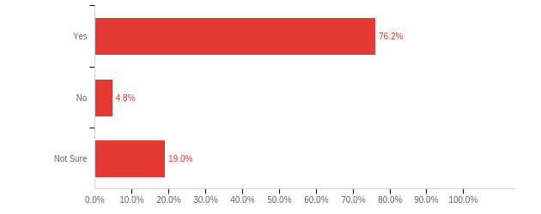
Would you use Simple Syllabus again?

Slide 13
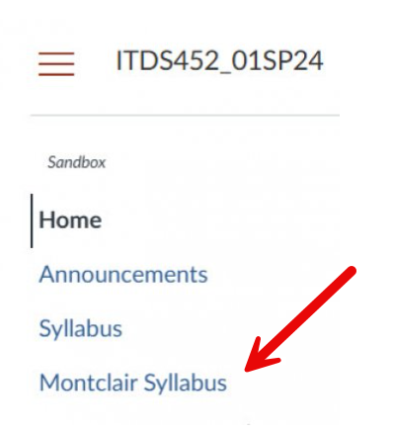
Default Option for Fall 24
Starting in Fall 2024, “Montclair Syllabus” (Simple Syllabus) will be a default menu item in Canvas courses.

Slide 14
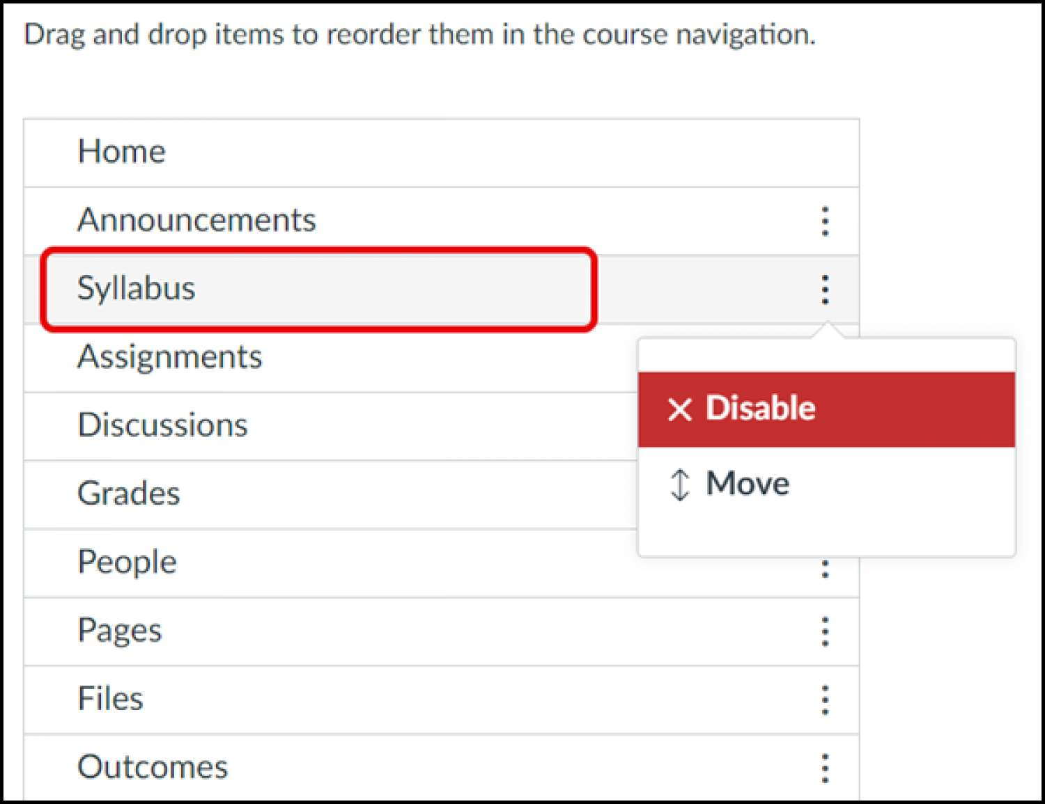
Remove “Syllabus” from Canvas navigation
Click on Settings in the course navigation.
Click on the Navigation tab.
Locate “Syllabus” under the section “Drag and drop items to reorder them in the course navigation” at the top of the page.
Click on the 3 dots and choose Disable.
Click “Save.”

Slide 15
Training and Support
Simple Syllabus Website
Simple Syllabus Workshops
One-on-One Consultations
The Montclair Syllabus (overview)
Google doc version of the template (if you’d like to complete and then copy and paste into the online template)

Slide 16
Demo and Questions?

